Slide 1


Generational Mixes in the Workplace

Slide 2






Presentation Outline
Workplace Mix
Millenials in Local Government
Innovative Leaders & Organisations
“Collaboration is the new Competition”

Slide 3



Workplace Mix

Slide 4
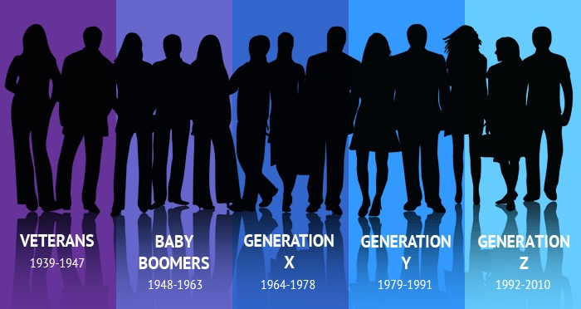

Slide 5
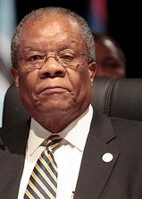


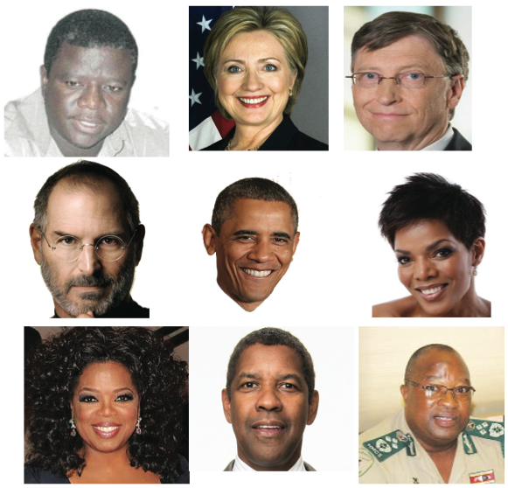
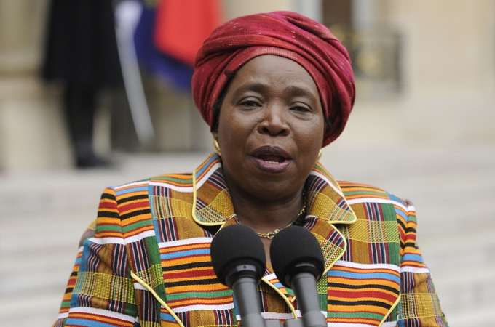
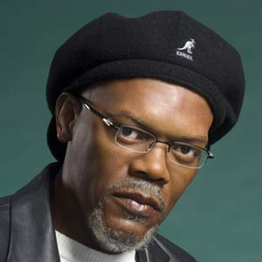
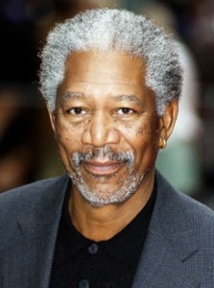
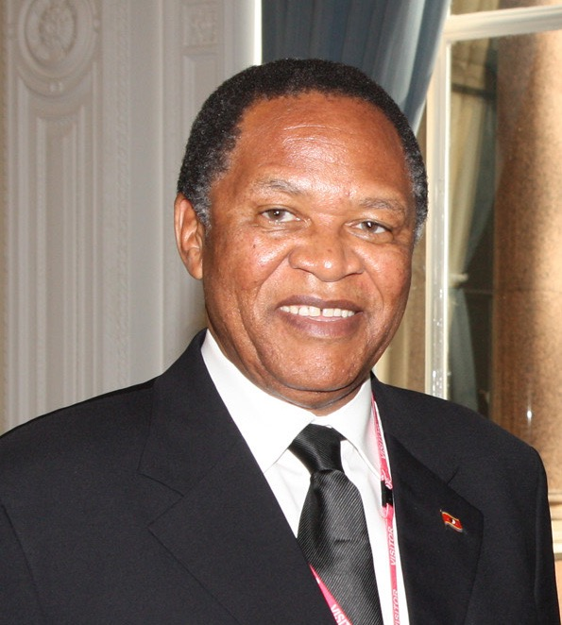
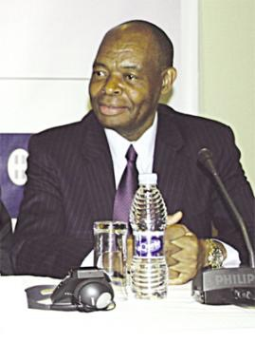

Multiple Generations
Silent Generation / Traditionalists
1965 - 1980
Baby Boomers
1946 - 1964
Ages 67 - 75
Ages 48 - 66

Slide 6
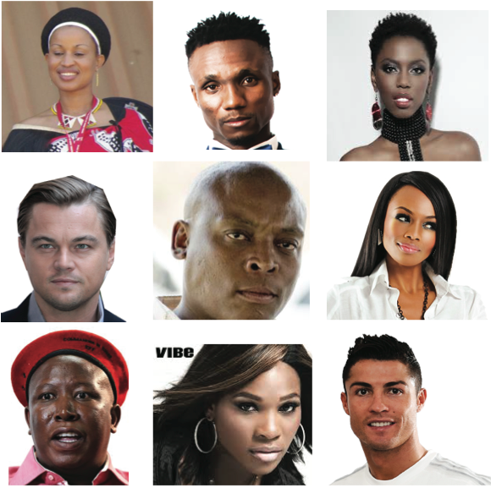

Multiple Generations
Generation X
1937 - 1945
Generation Y - Millenials
1981 - 2008
Ages 36 - 47
Ages 19 - 35

Slide 7
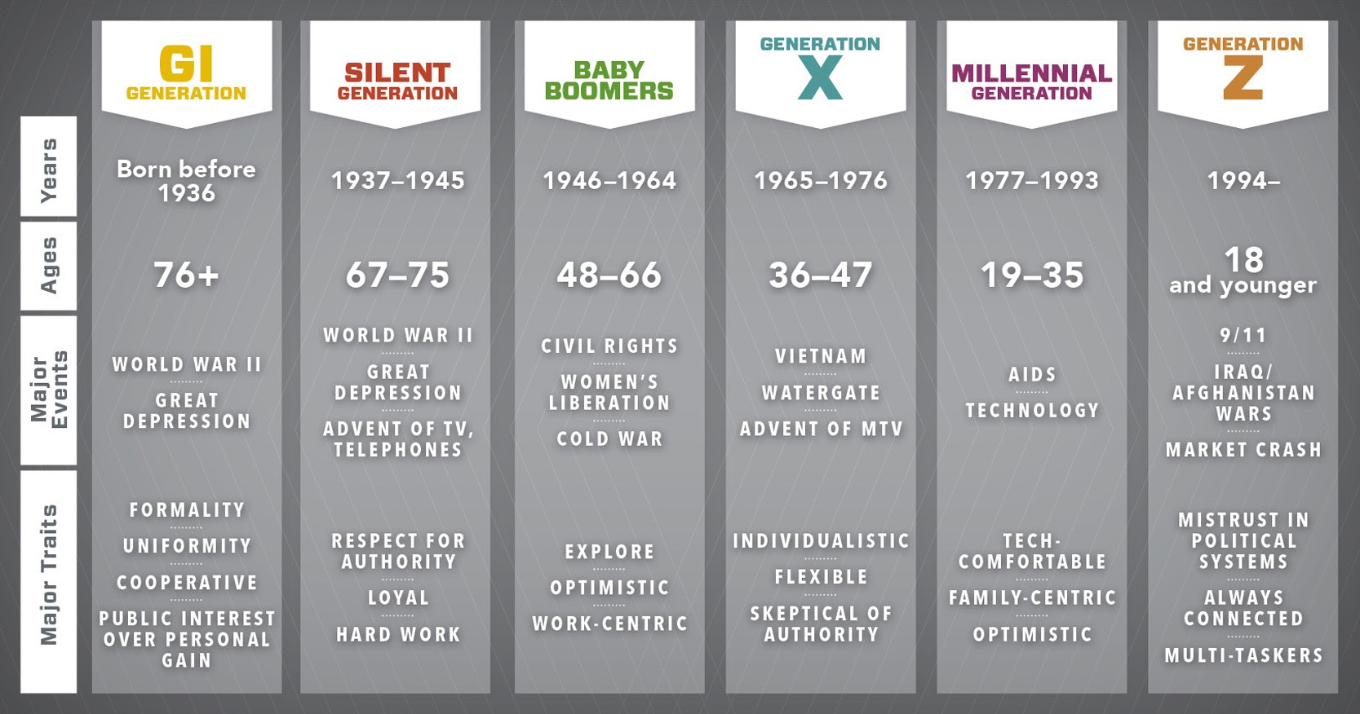

Slide 8
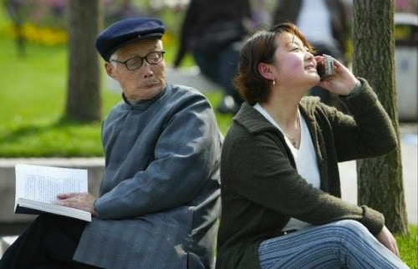
Silent Generation: Traditionalists
  Includes everyone born before 1945 (67 – 75 years)
  Less than 1% workforce today
  Respect authority and expect respect for a job well done.
  They are hard workers and stick to instructions given.
  Most have stayed with one company most of their career.

Slide 9

Baby Boomers
  Born between 1946 & 1964 (48 – 66 years)
  Make up approximately 30 - 35% of today’s workforce.
  Respect authority and often hold higher management positions.
  They offer more ideas than Traditionalists and expect to lead, not follow.
  E.g. Bill Clinton, George Bush

Slide 10

Gen Xers
  Born between 1965 & 1982 (36 – 47 years)
  Make up about 35 - 40% workforce
  They know and understand technology and want to use it.
  May have lots of career interests and paths.
  They demand individuality and like multi-tasking.
  E.g. Jennifer Lopez, Victoria Beckham

Slide 11
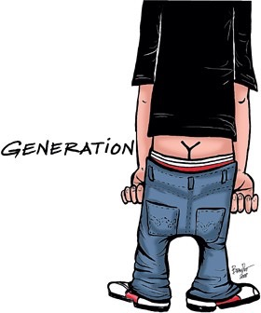
Millenials / Generation Y
  Born between 1983 and 2000 (19 – 35 years)
  35% of the current workforce but rising rapidly
  Not only expect technology in every form, but demand it - would be lost without the Internet or gadgets.
  Dress code not especially important
  Seek out jobs where their creativity is most important and rewarded.
  E.g. Justin Bieber, Rihanna

Slide 12
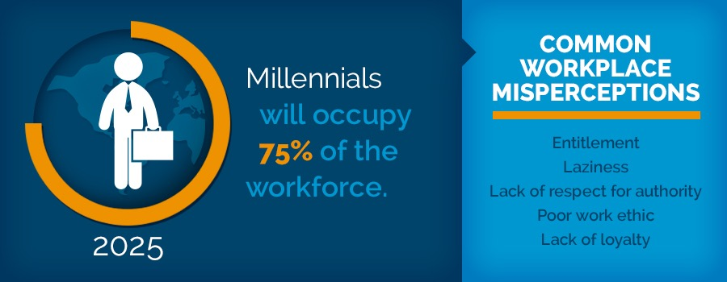


Slide 13
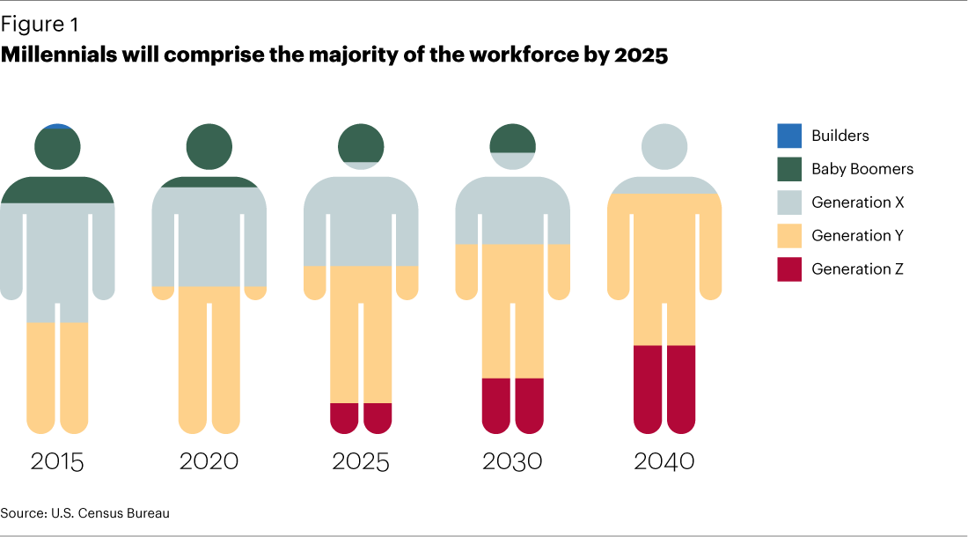

Slide 14
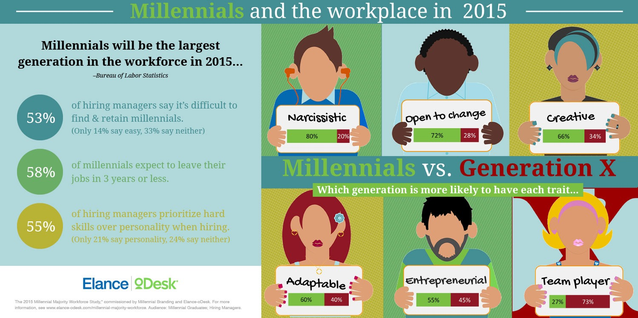

Slide 15
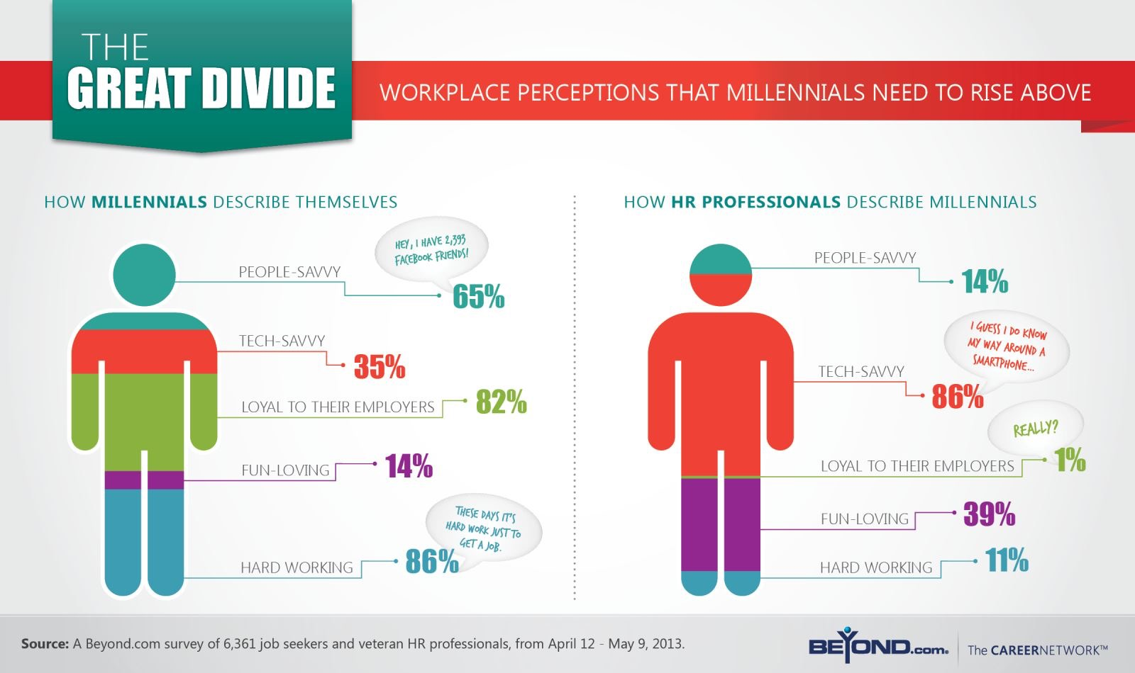

Slide 16

Millenials in Local Government

Slide 17
Millenials in Local Government
  SmartGovCommunity – “millenials are a force of change in Government in 3 ways:
  Millenials as Citizens – trips to city hall decrease and demand for online will increase (digital government), instant services
  Millenials as Leaders – coming into their own power in their 30’s, organisational culture change, flexible work arrangements enabled by mobile technology
  Millenials as Civic Employees – make local government compelling and enticing career path

Slide 18
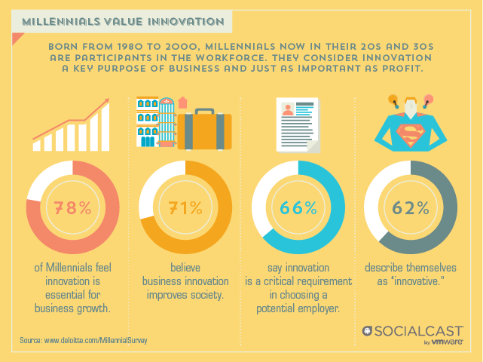

Slide 19
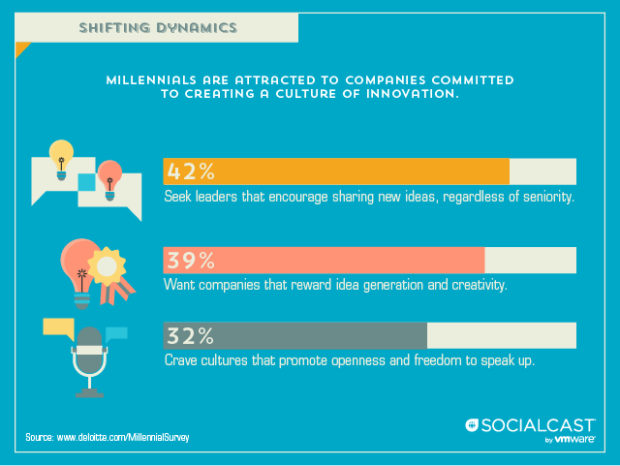

Slide 20
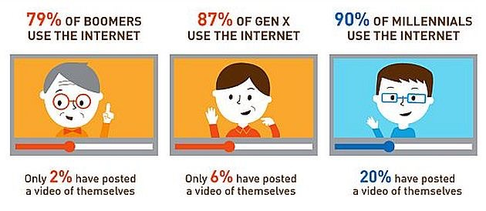
Generations & Technology

Slide 21
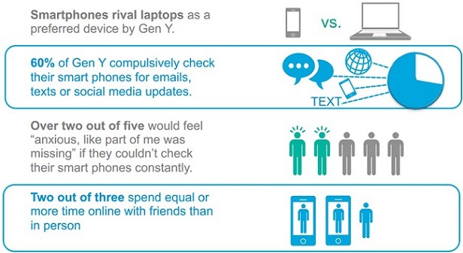
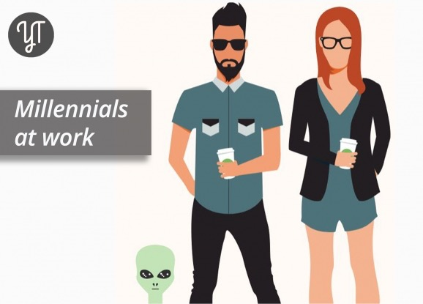
Millenials & Technology

Slide 22
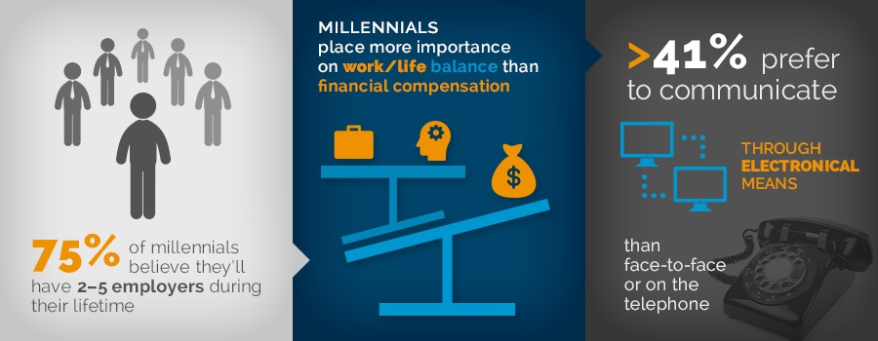

Slide 23
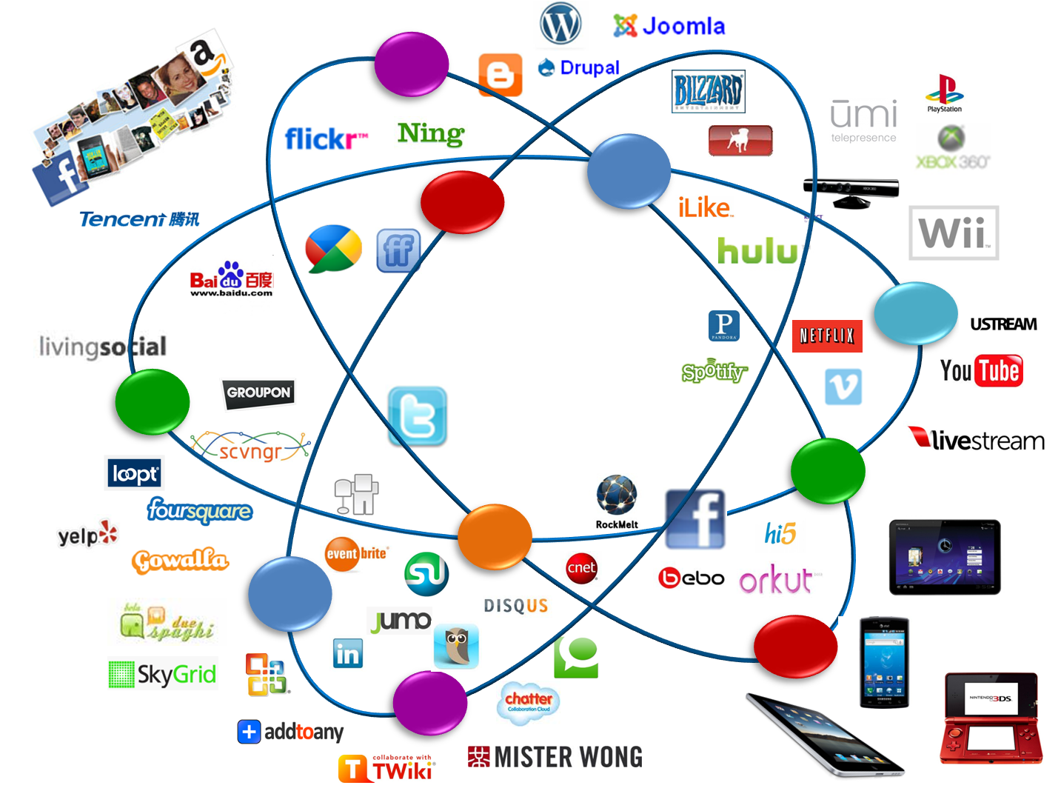

Slide 24


Innovative Leaders & Organizations

Slide 25
Innovation Leadership: 2 Components
  1. An innovative approach to leadership
  Bring new thinking & different actions - Innovative thinking is a crucial addition to traditional business thinking. It allows you to bring new ideas and energy to your role as leader and to solve your challenges
How to think differently about roles & organizational challenges
How to break open entrenched, intractable problems?
How to be agile and quick in the absence of information or predictability?

Slide 26
Innovation Leadership: 2 Components
2. Leadership for innovation
Create organizational climate - innovative thinking
Growing a culture of innovation, not just hiring a few creative outliers
Helping others to think differently & work in new ways to face challenges?
Innovation when all resources are stressed and constrained?
Staying alive and stay ahead of the competition?

Slide 27
Business Thinking Versus Innovative Thinking
Traditional business thinking |  | Innovative thinking
Logical |  | Intuitive
Deductive / inductive thinking |  | Abductive reasoning
Requires proof to proceed |  | Asks what if?
Looks for precedence |  | Unconstrained by the past
Quick to decide |  | Holds multiple possibilities
There is right or wrong |  | There is always a better way
Uncomfortable with ambiguity |  | Relishes ambiguity
Wants results |  | Wants meaning

Slide 28
2 Sides of the Same Coin
Design
Innovative Thinking Skill
Innovation Leadership
Interpretive: Look for different perspectives
Perceive more deeply, beyond first impressions
Paying Attention
Personal: consider the customers point of view
Tap into personal experiences to gain fresh perspectives
Personalizing
Abductive: redefine the problem, as what if
Bring information to life through use of metaphors
Imaging
Experimental: rapid prototyping, make solutions feel real
Generate insights through exploration & experimentation
Serious Play
Collaborative: share insights and ideas
Foster productive dialogue by embracing diverse viewpoints
Collaborative Inquiry
Integrative: consider the whole
Synthesis, rather than analysis
Crafting

Slide 29
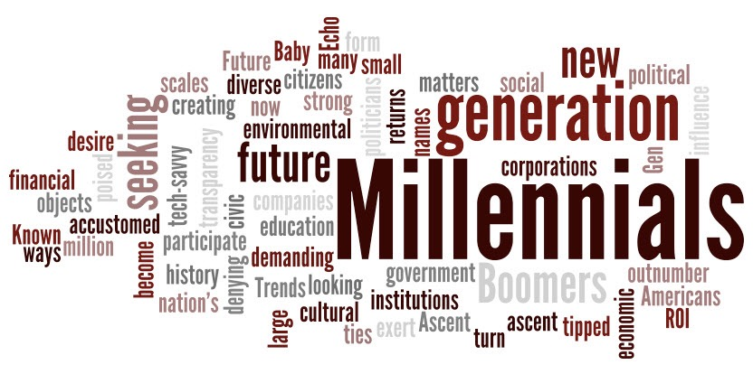
“COMPANIES CAN NO LONGER EXPECT THEIR EMPLOYEES TO BE LOYAL ENOUGH TO STAY FOR 10 OR 20 YEARS, AND MAYBE THAT’S A GOOD THING.”
Harvard Journal
Har

Slide 30

Thank You

