Slide 1
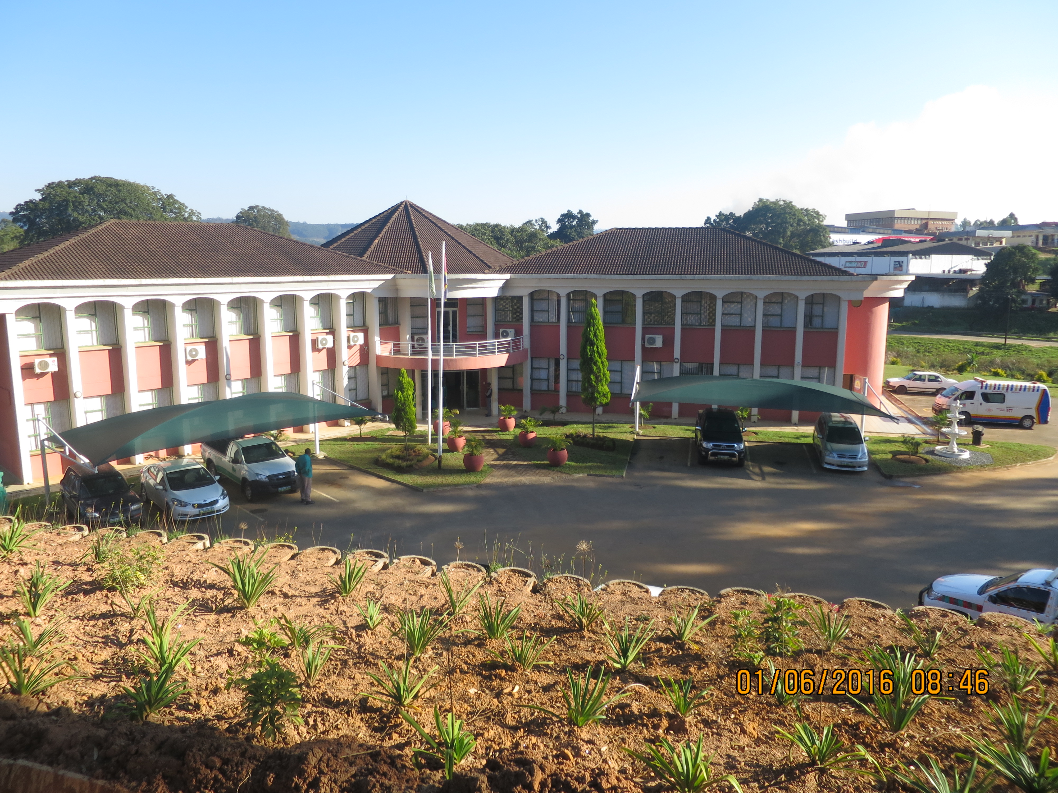

USING GOVERNMENT LAND AS A REVENUE SOURCE – THE LEASE OF GOVERNMENT LAND TO PEAK TIMBERS
BY ; MZWANDILE NDZINISA

Slide 2
1. INTRODUCTION
The government of Swaziland entered into a lease agreement with the then Mondi Forest (currently Peak Timbers), for lease of Portion 63 of farm 2, Hhohho, measuring 287 hectares for the sole purpose of timber plantation.
This farm was previously occupied by residents of Malandalahle township and as part of the resettlement process, it was agreed that the yearly rental paid by Peak Timbers be channelled towards the development of Piggs Peak, through financing capital projects and social amenities.

Slide 3
During 2016/17 financial year, E582 242 was paid by Peak Timbers to Council as rent and the yearly rental amount escalates according to the prevailing inflation rate.
Duration of current lease – 2037

Slide 4
2. HOW DOES THIS LEASE QUALIFY TO BE A PUBLIC PRIVATE PARTNERSHIP ?
Peak Timbers entered into a agreement of land lease with the government for timber plantation.
Since Council is charged with the responsibility of managing government land within the urban area, it was agreed that Pigg’s Peak Town Council uses the annual rent to finance capital projects and social amenities

Slide 5
3. PROJECTS UNDERTAKEN THROUGH MONEY GENERATED FROM THIS LEASE
Construction of civic centre - partly
Construction of Malandalahle road and installation of street lights
Construction of road leading to Piggs Peak Correctional facility / Prison
Besides these monetary gains, this lease has resulted in employment creation, since a majority of the town’s residents are employed in the timber industry

Slide 6
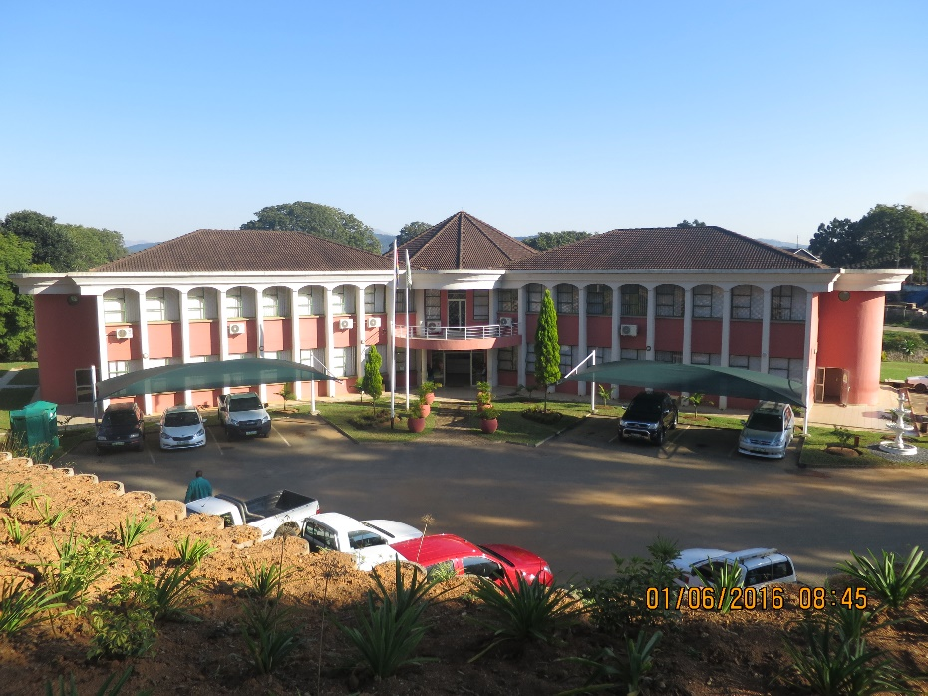
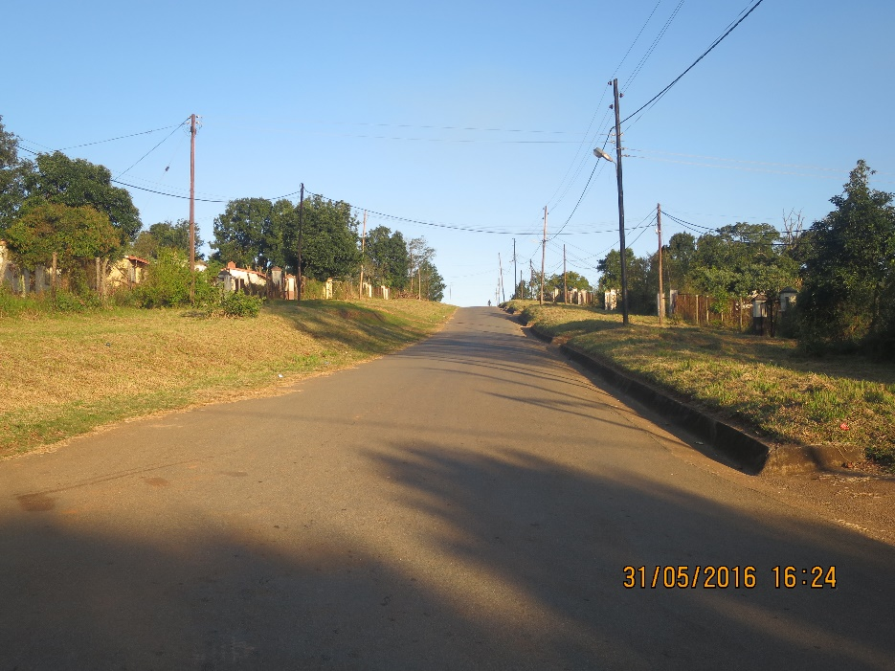
Projects financed through proceeds from land lease
Pigg’s Peak civic centre
Road leading to Malandalahle

Slide 7
4.0 OTHER PUBLIC PRIVATE PARTNERSHIP IMPLEMENTED WITHIN PIGG’S PEAK
Peak Piggs Plaza – developed in 1993 and development comprises of a shopping centre, filling station, bus rank, market and public toilets .
Value of development – E12 200 000
Benefits – rates payment
Duration of lease – 2043, thereafter development will be transferred to government

Slide 8

THANK YOU !!!!!!

