Slide 1

NHLANGANO TOWN COUNCIL
MANGWANENI SETTLEMENT: A DEVELOPMENT PARADOX
6 APRIL 2017
PRESENTED DURING THE LAMAS CONVENTION

Slide 2

HISTORICAL BACKGROUND

Slide 3
TERRITORIAL EXTENT AND CONDITIONS
Covers 4-5 ha of non-surveyed Crown Land
Over 100 units erected
Housing units are made of informal material
Many are not connected to utility services

Slide 4
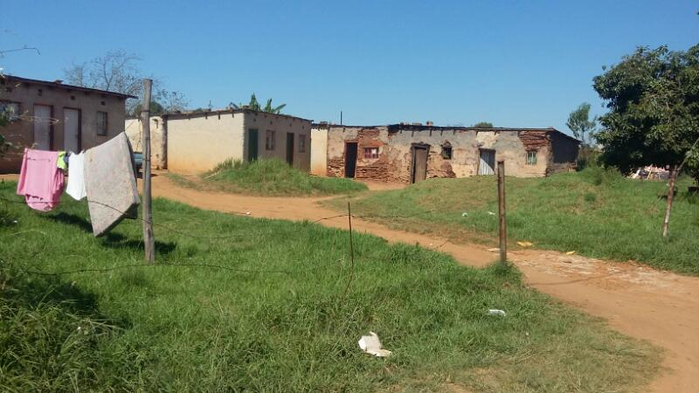
TERRITORIAL EXTENT AND CONDITIONS

Slide 5
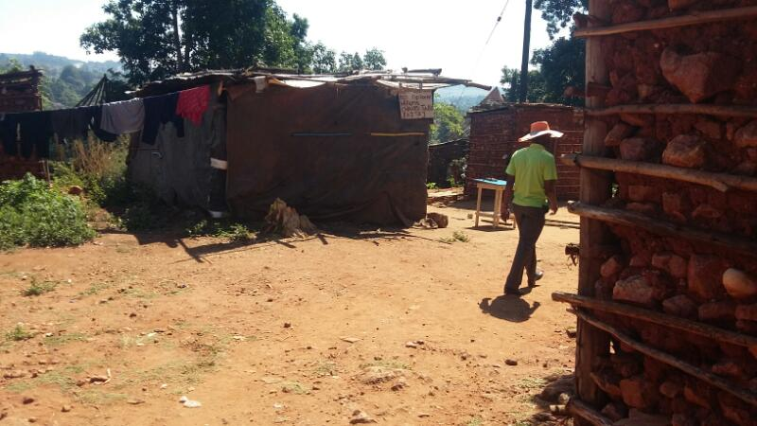
TERRITORIAL EXTENT AND CONDITIONS

Slide 6
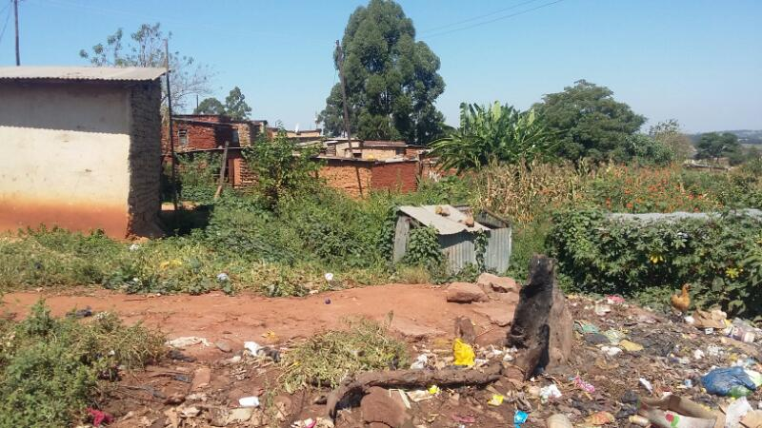
TERRITORIAL EXTENT AND CONDITIONS

Slide 7
GOVERNANCE
Not very clear
Leadership Committees often put into office, using unclear mechanisms
Mandate of the Committees not clear
Confusion and conflicts often occur

Slide 8
ENSUED ENGAGEMENTS
Office of the Regional Administrator
    Working on “Swazi Village”
    Working on clear guidelines on extent, management, operations and development of Emangwane
Ministry of Housing and Urban Development
    MHUD has challenged the municipality to contribute to development of a concept note on the institutionalization and management of Emangwane.
    Proposed statistical and cartographic surveys
Leadership Committees

Slide 9
PROPOSED WAY FORWARD
Engagements at higher level (MHUD, MTAD, King’s Office, etc)
Financing model for development of Emangwane
Strict controls on general urban sprawl
Forward planning
Amongst many other required interventions

Slide 10
THANK YOU

