Slide 1

COMMUNITY ENGAGEMENT IN EZULWINI
Vusumutiwendvodza Matsebula
- Town Clerk/CEO

Slide 2

Introduction
Ezulwini is physically located along the Mbabane – Manzini corridor.
Surrounding areas to Ezulwini Municipality are; Lobamba, Mvutjini, Buka, Gelekeceni , Nshakabili and Nyonyane.
Lobamba and Mvutjini being the closest areas to the Town.

Slide 3

Community Engagement
Ezulwini Municipality views community engagement as efforts and resources of the Local urban government and of the peri-urban community jointly knit together to combat a certain challenge or situation.
Although there both parties differ in leadership, common ground needs to be reached in order to achieve the goal at hand, be it social welfare, crime or any other challenge.

Slide 4
Social Welfare
The AMICAALL department champions most of the community engagement projects related to health and social welfare in Ezulwini.
Youth (In and out of school health clubs)
Soci0-economic development
Neighbourhood care-points/Social Centres (6)

Slide 5
Social Welfare
This includes working with community volunteers/care givers which are funded by the Municipality.
From that the Municipality has been able to see the progression of financial saving schemes for the different communities in the peri-urban areas of Ezulwini.

Slide 6
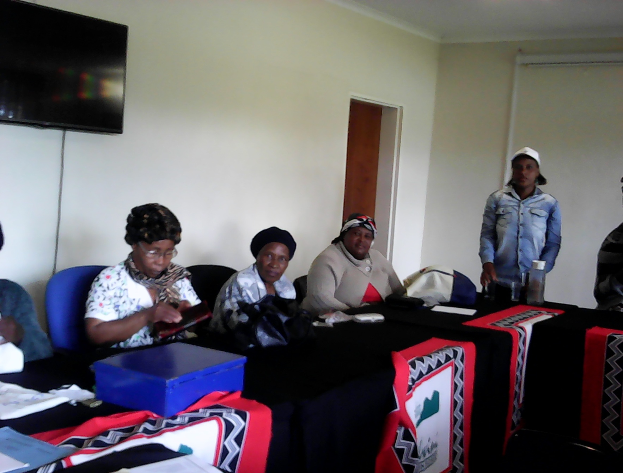
Caregivers

Slide 7
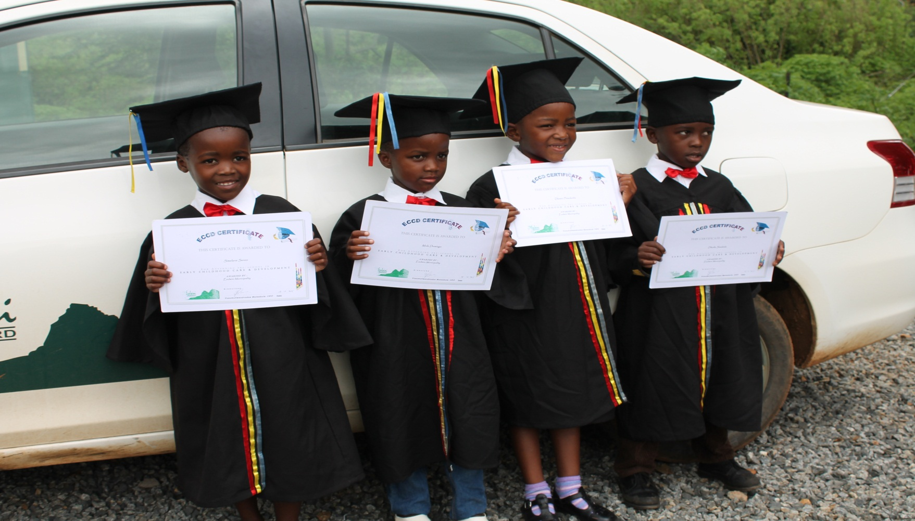
Buka Social Centre Graduation

Slide 8
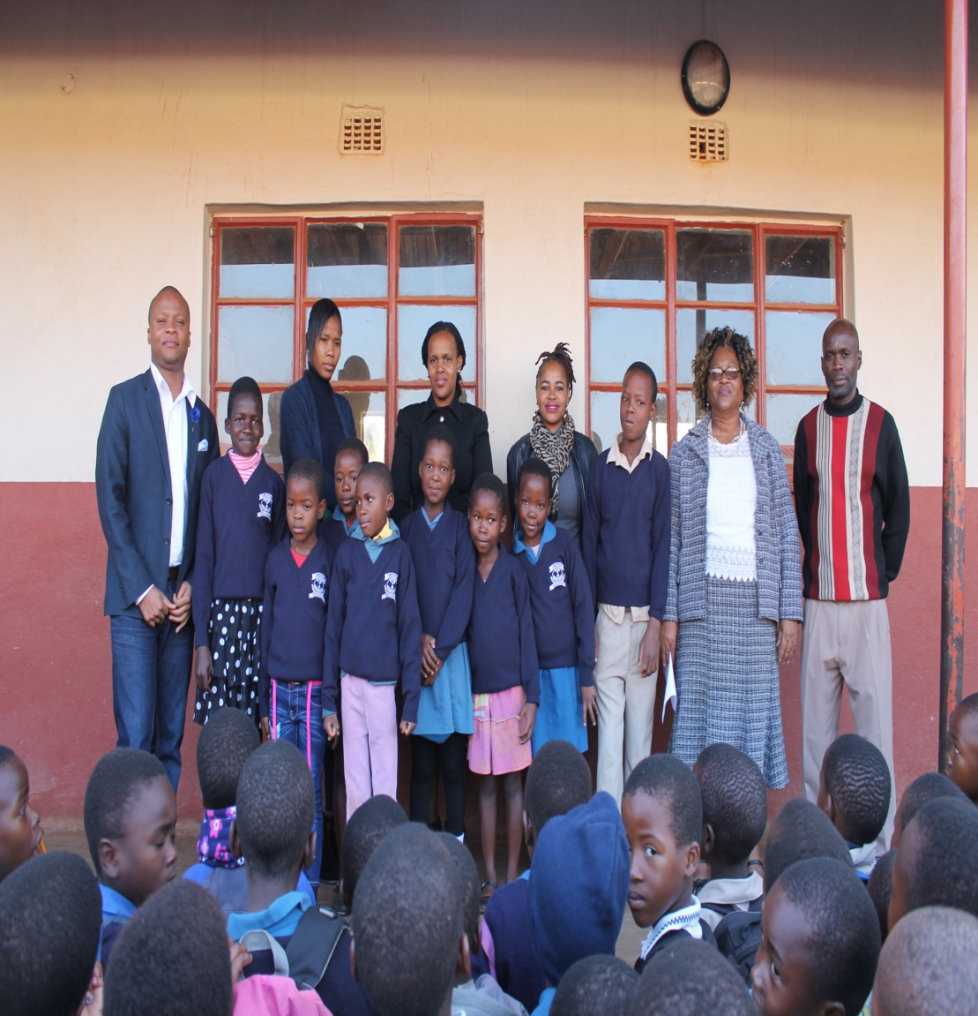
Warm winter: School jersey gift for Elangeni
Primary school students

Slide 9
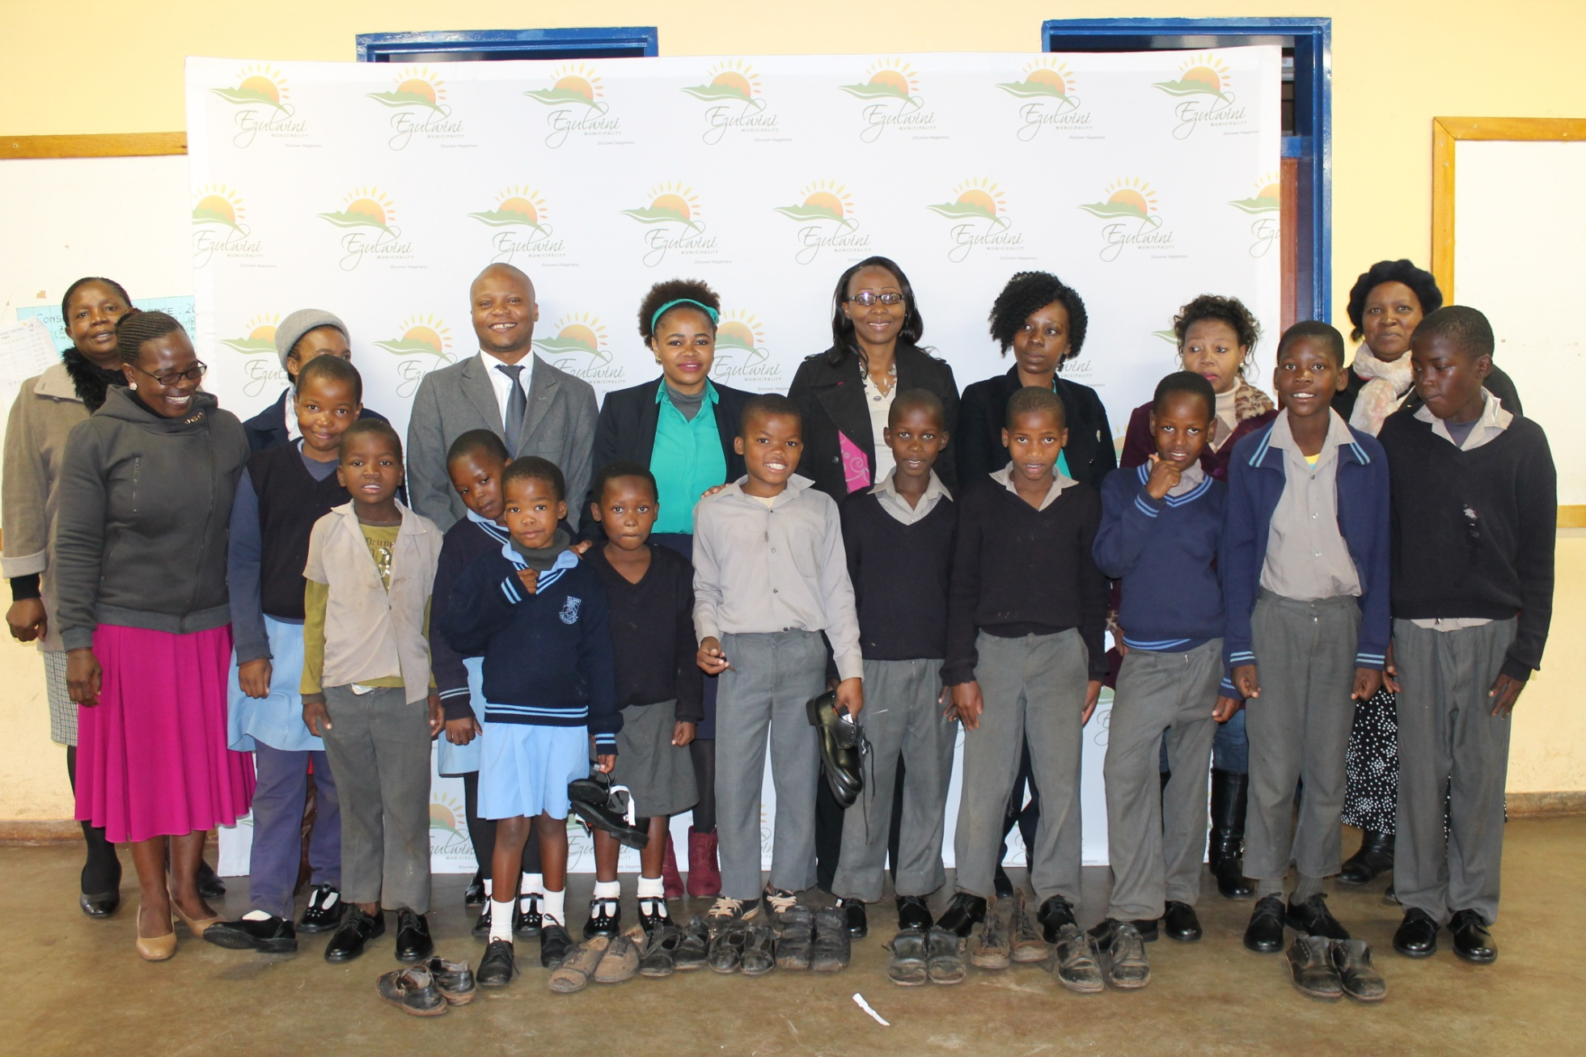
School shoe campaign for Ezulwini Community Primary

Slide 10
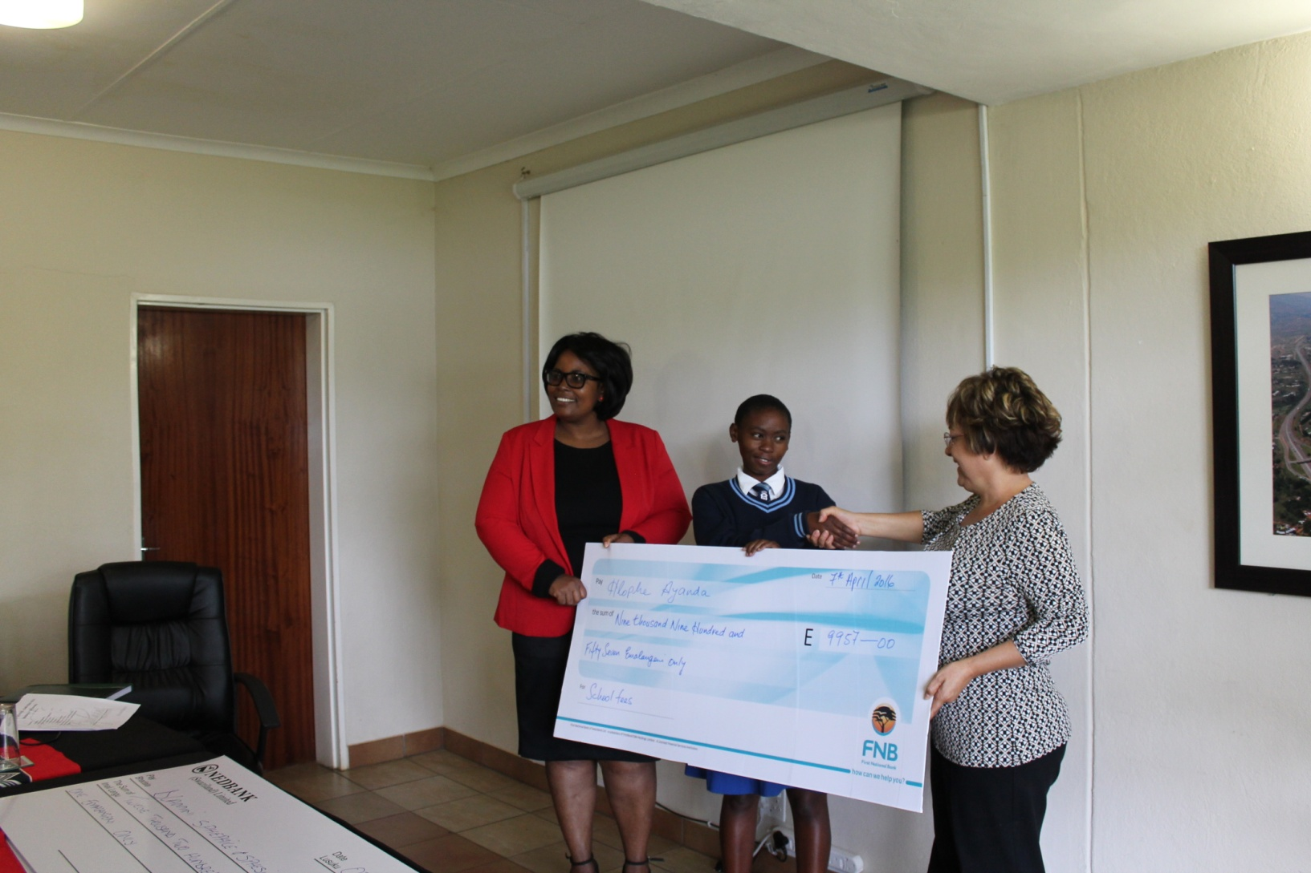
School fees sponsorship

Slide 11
Youth Health Clubs
The Municipality has also been a co-ordinator for Kobe High School Community Service training which engages students who volunteer in the children's centres.
This allows the youth of the Urban area interact with other young people and somehow have positive impact towards their lives and the lives of the children in the centres
Students have given towards the improvement of the centres by, teaching donating food, and painting the centres as well.

Slide 12
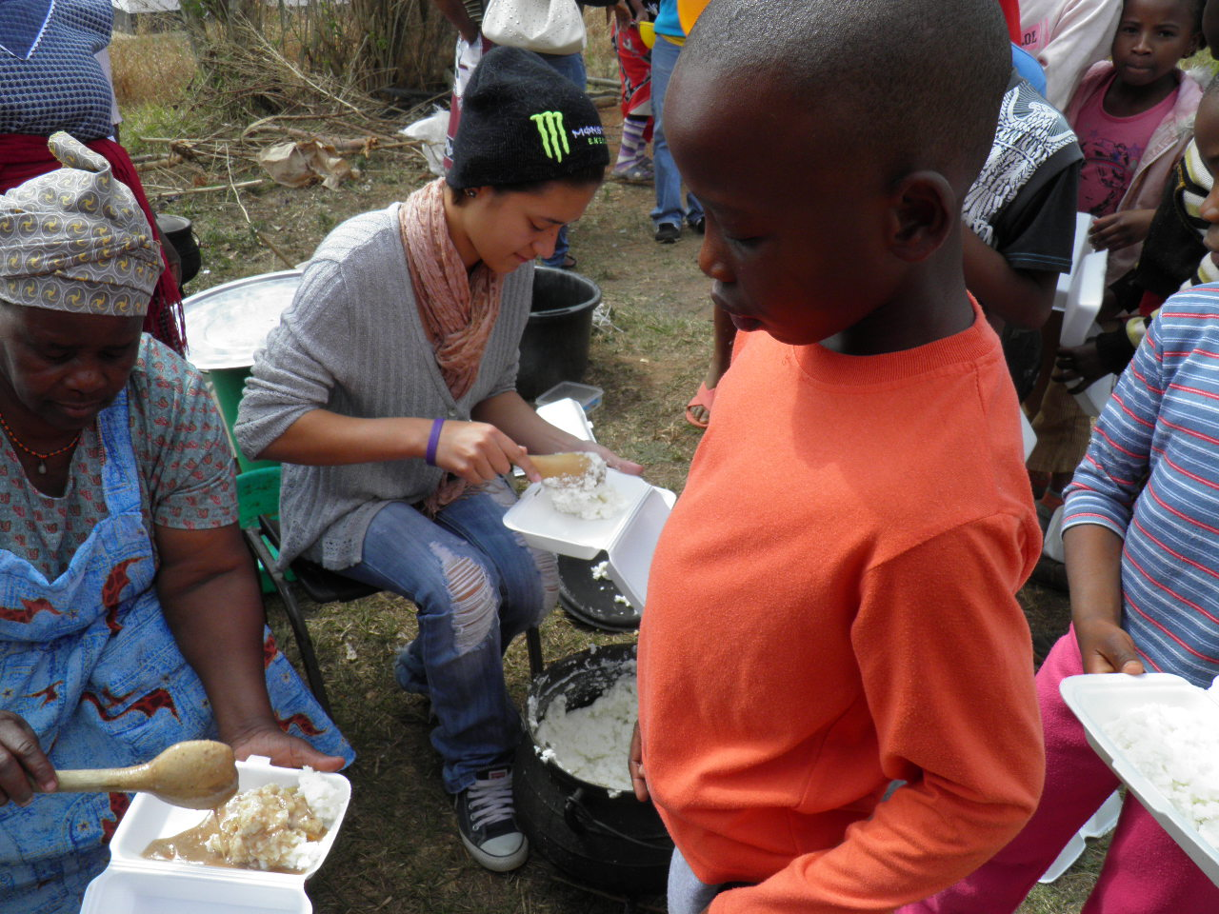

Community Service

Slide 13
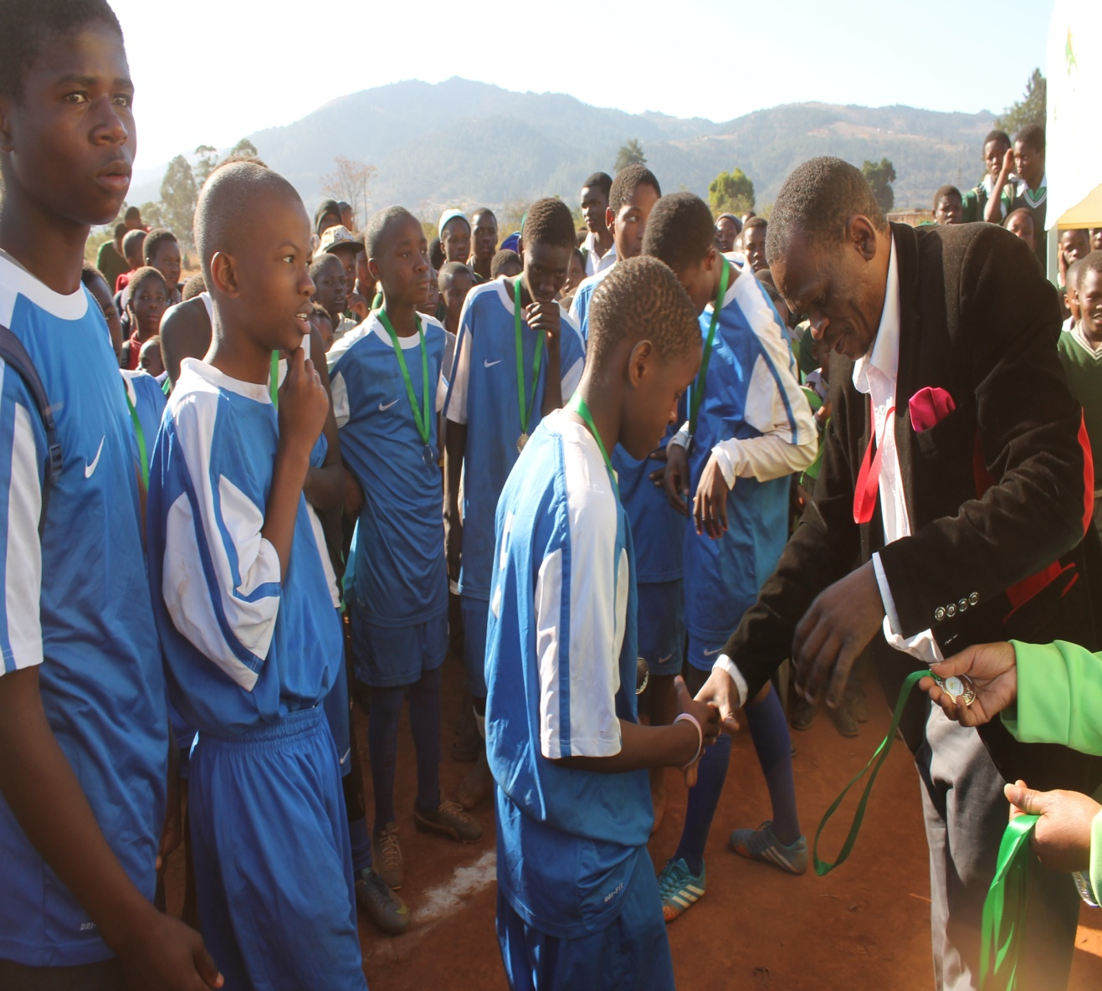


Slide 14
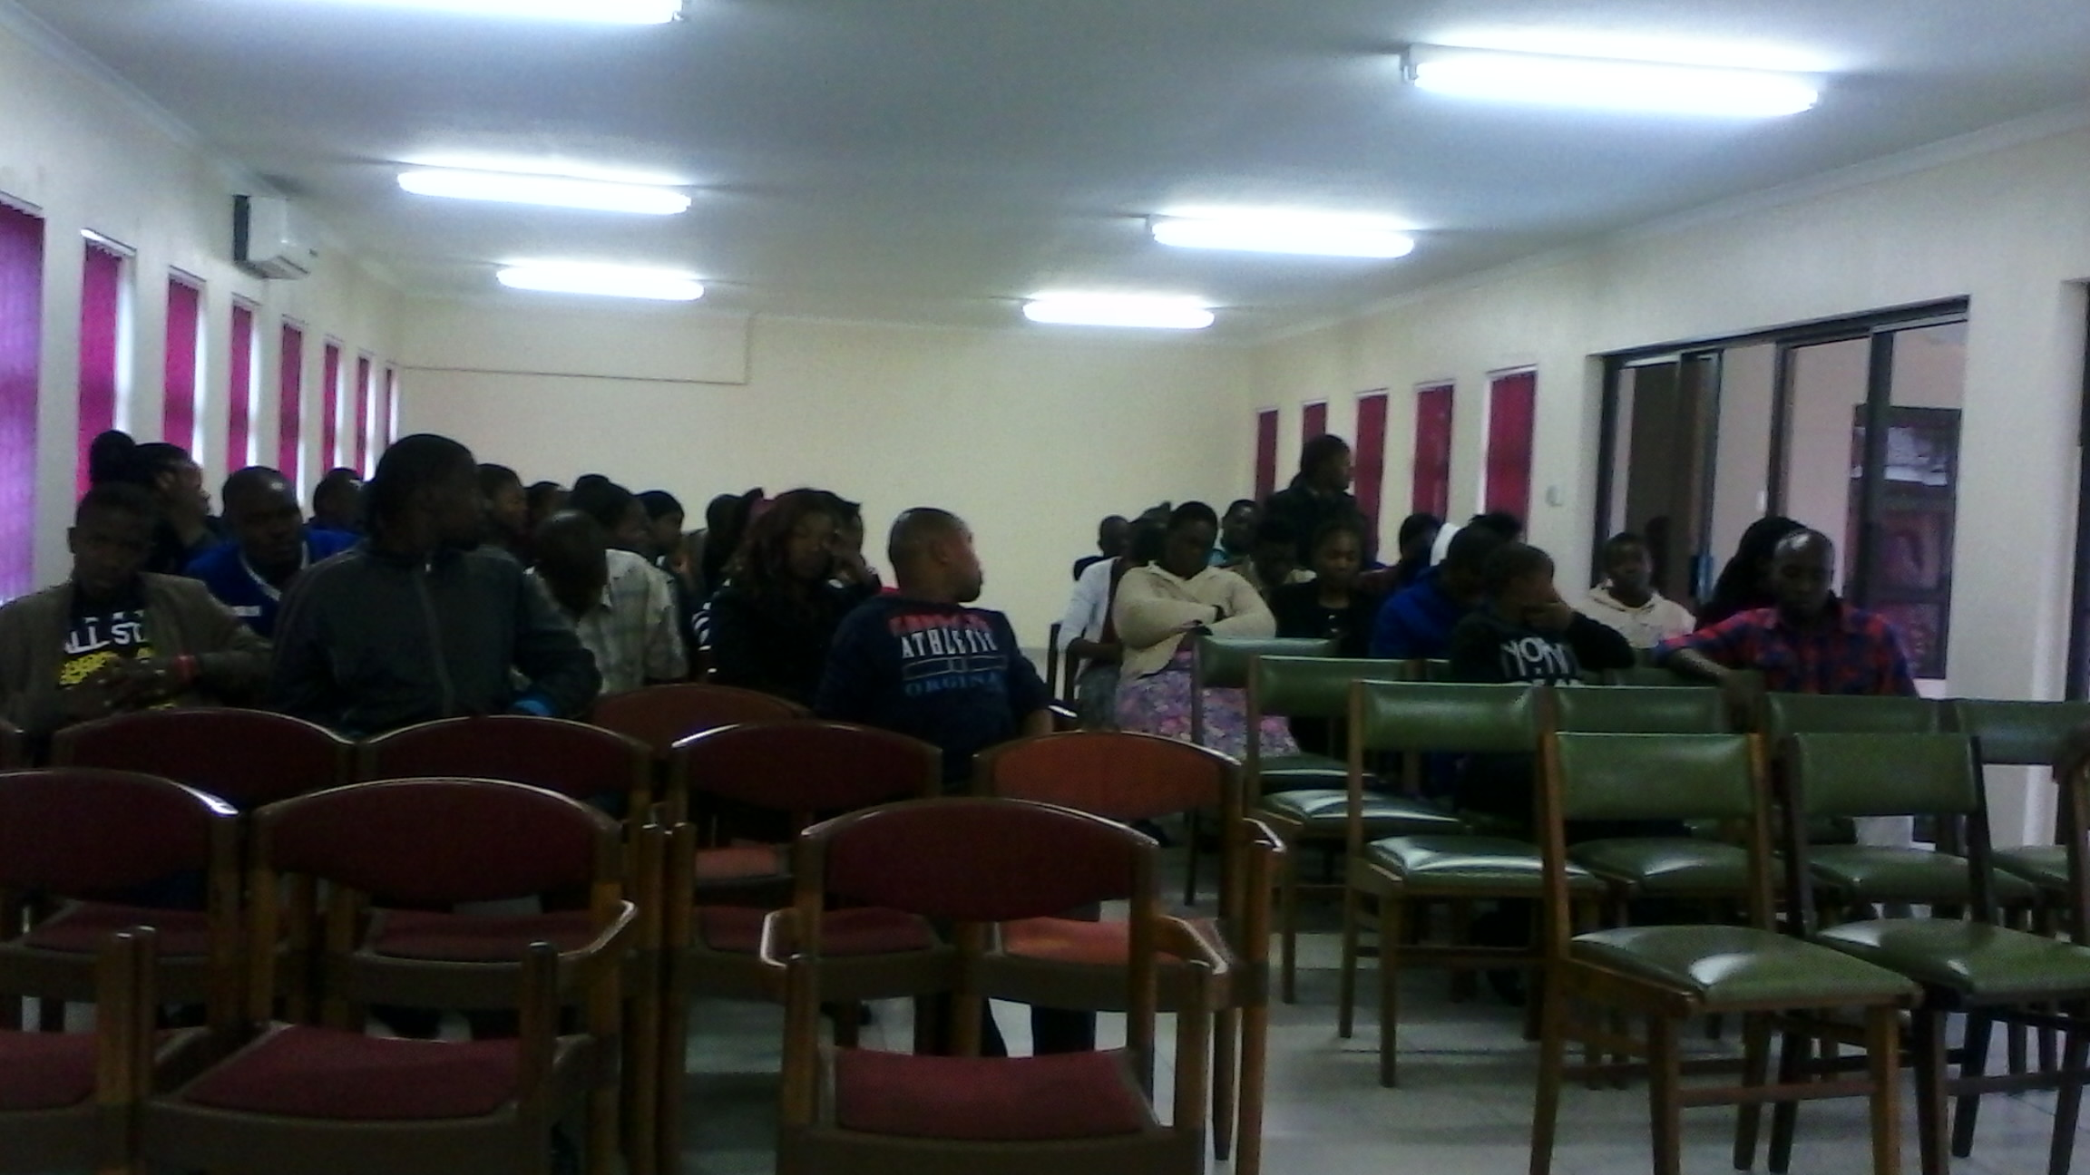
Youth Dialogues

Slide 15
Environmental
Waste is an issue in Ezulwini and mostly in the outskirts of the town where there are non- existent waste management systems
During the SADC Summit the Municiaplity was able to collaborate with Mvutjini youth and the Nshakabili youth.
From there the local authority has forged a relationship to have regular clean-up campaigns.

Slide 16
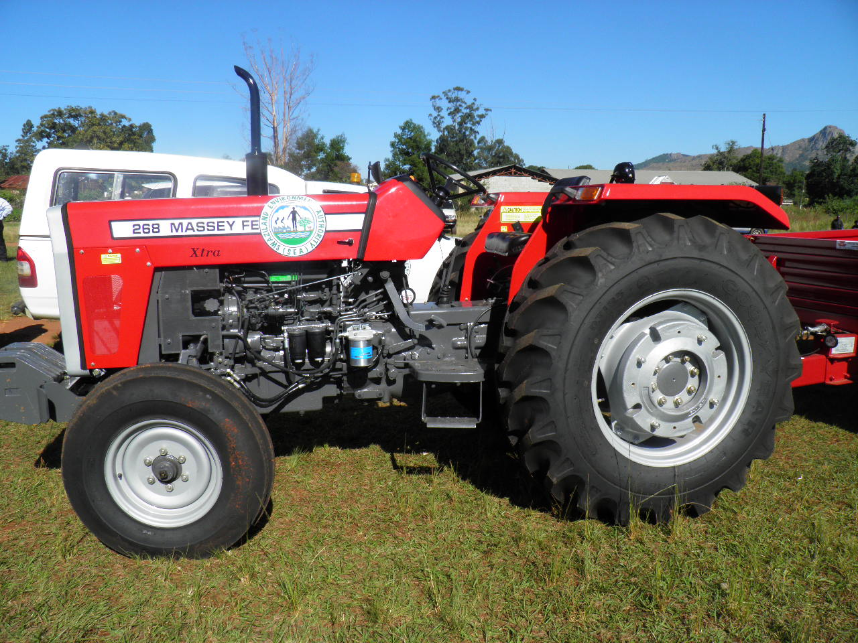
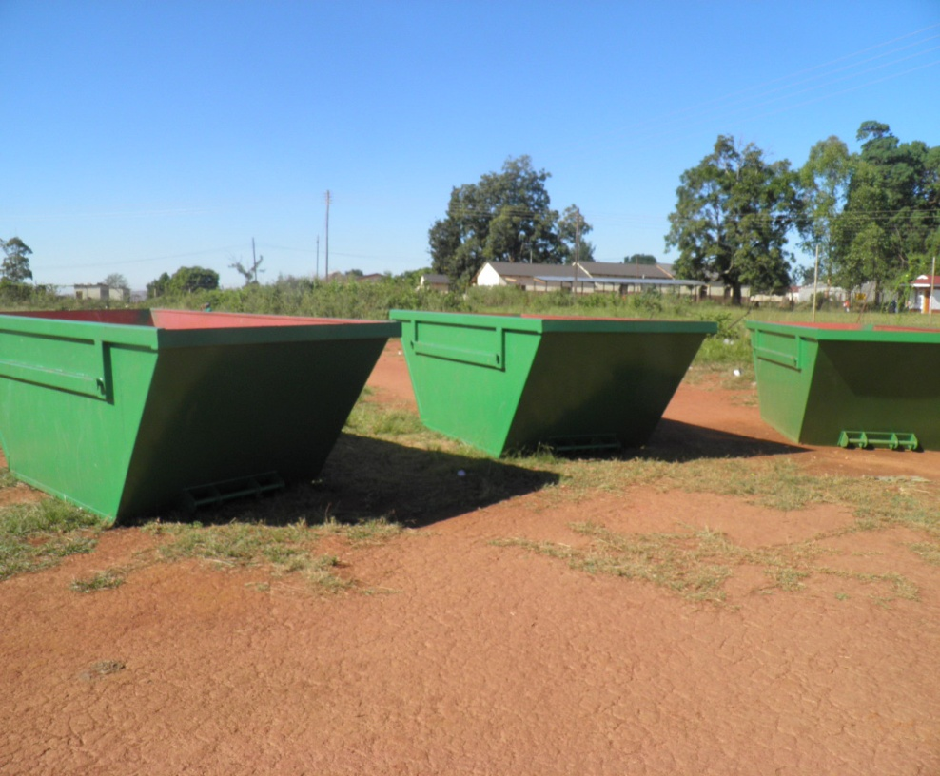
Lobamba Conservation Club: SEA donated skip bins to Lobamba and the Municipality assist with transportation of waste.

Slide 17
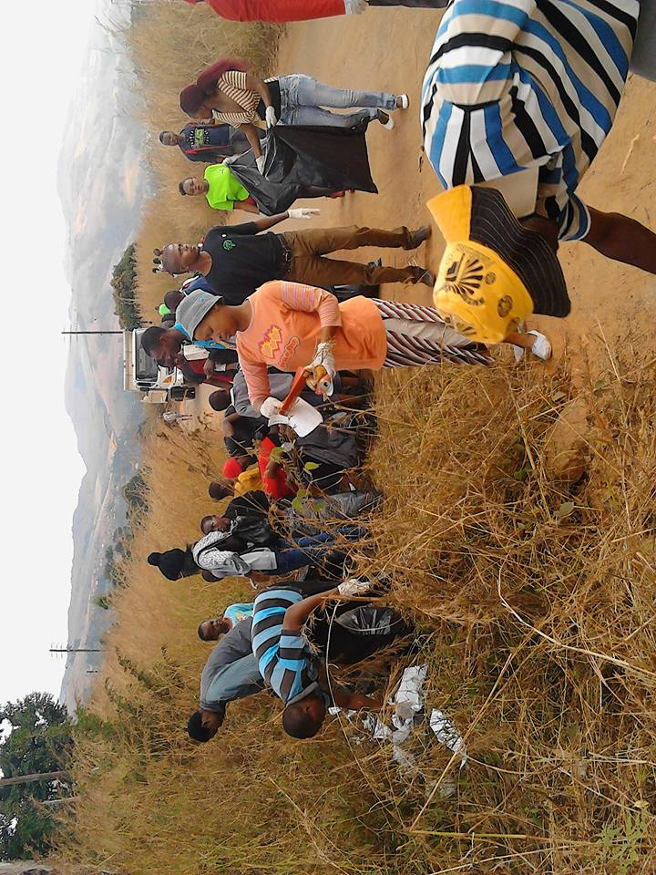

Mvutjini Parish youth clean- up campaign

Slide 18
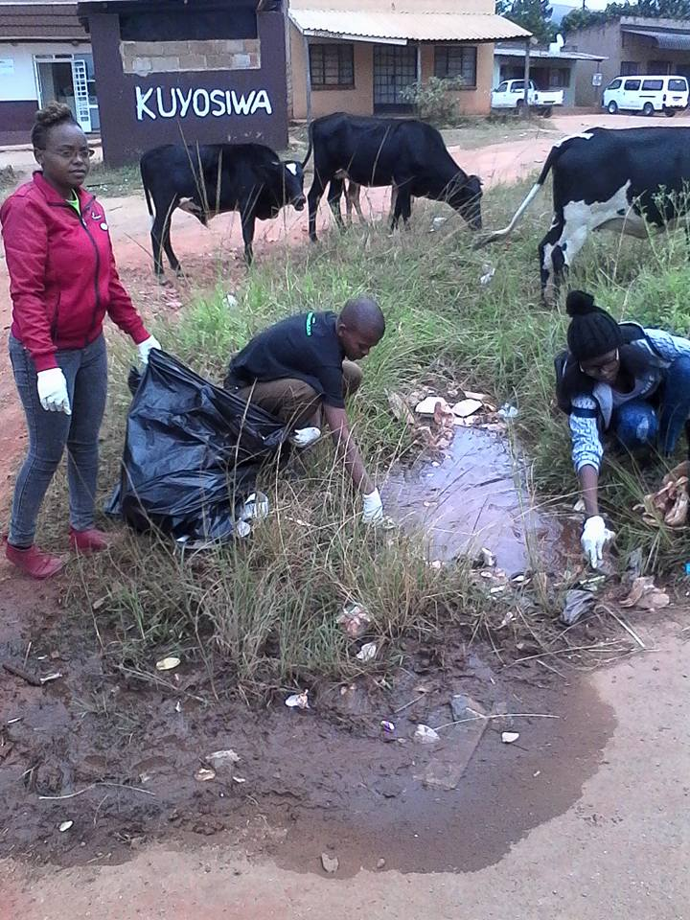
Mvutjini

Slide 19
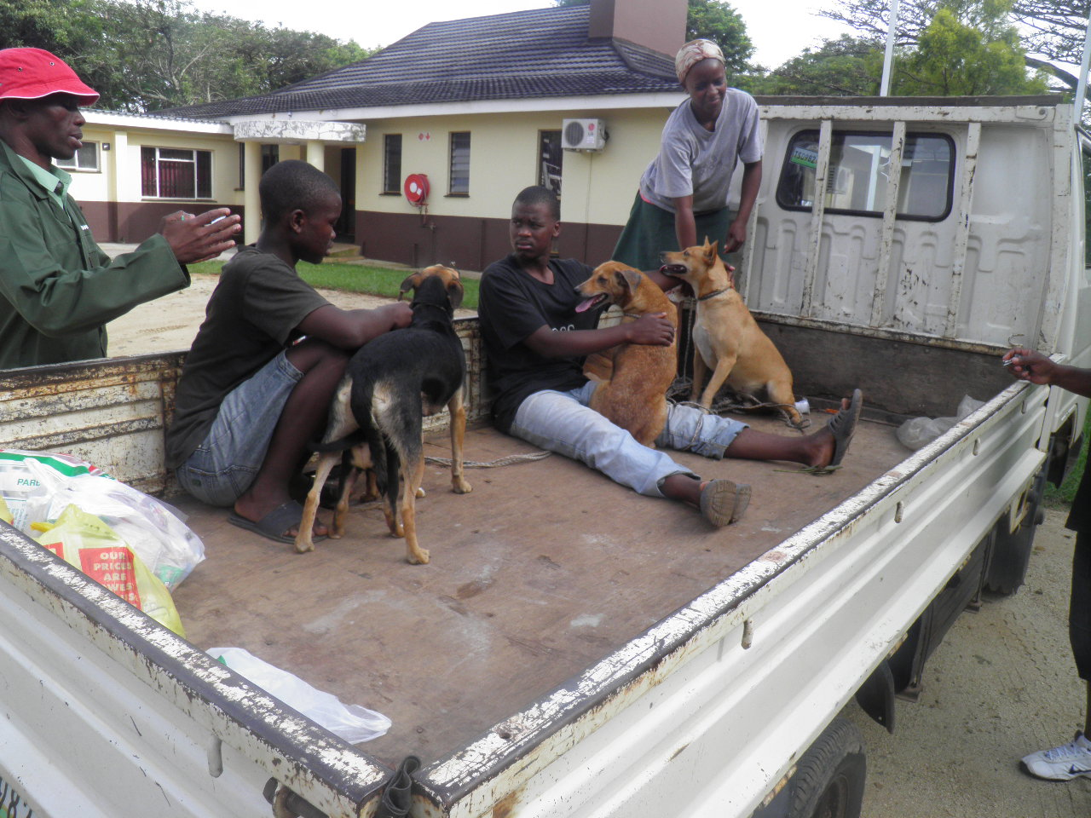

Ezulwini Municipality as a vaccination centre for the greater Ezulwini. The Ministry of Agriculture collaborates with local authority to combat zoonotic diseases.

Slide 20
Crime Prevention
The Municipality is cognisant of the fact that crime in the Urban and crime in the peri-urban area affects both urban residents and the community residents.
It would be unfair to combat crime in the urban area only as crime in the peri-urban area affects the urban.
In this regard the Municipality engaged the Royal Swaziland Police and of Ezulwini to have forum for a crime prevention for the greater Ezulwini and Lobamba Inkhundla

Slide 21
Future Collaborations
Meetings with Umphakatsi
Pound
Space for cemetery
Landfill

